Slide 1
Lunchroom Behavior

Slide 2
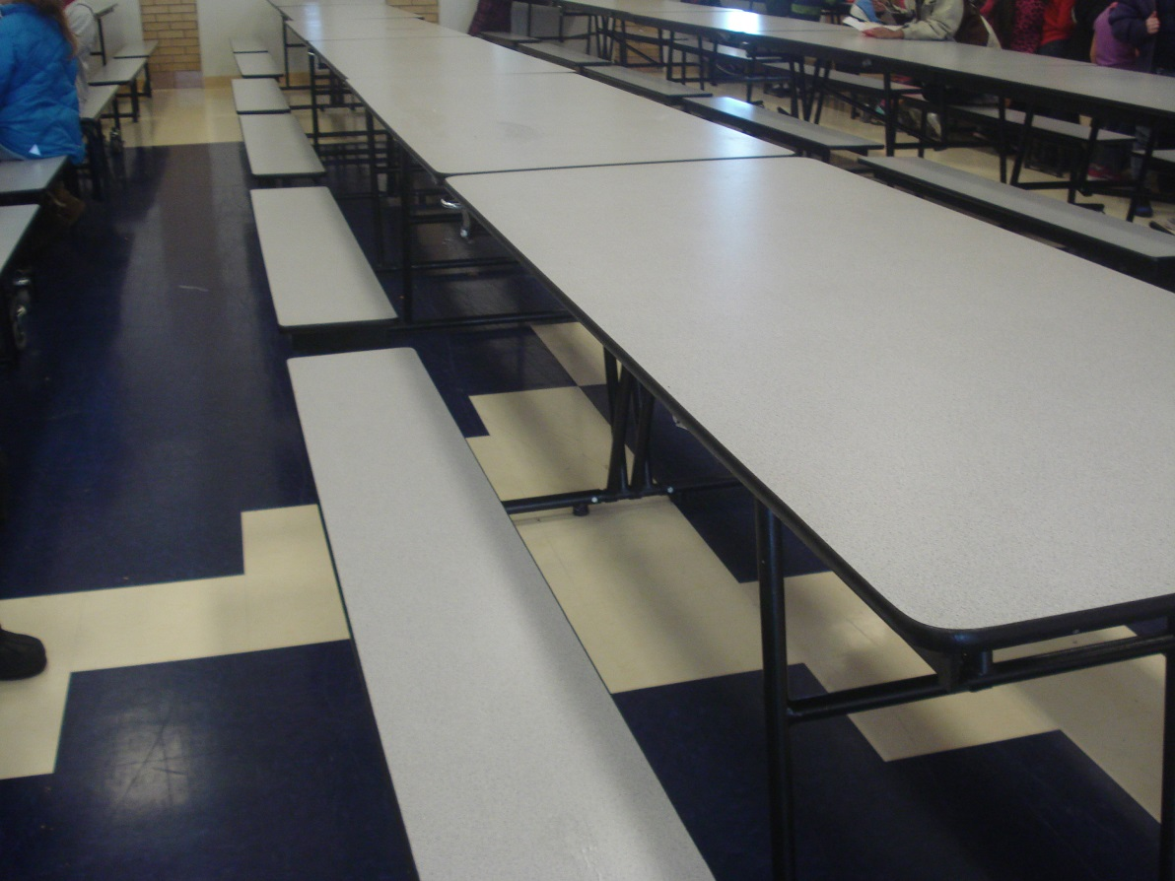
Keep the tables and floors clean!
When you leave the lunchroom, clean up your area.

Slide 3
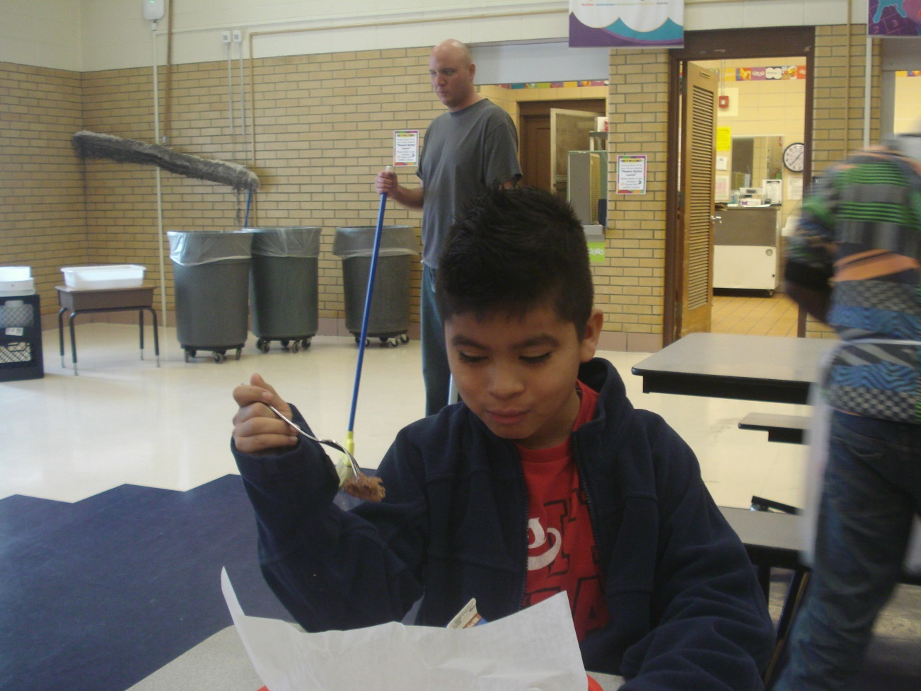
Eat your own food
Do not grab others’ food or ask them for food. Just eat your own food.

Slide 4
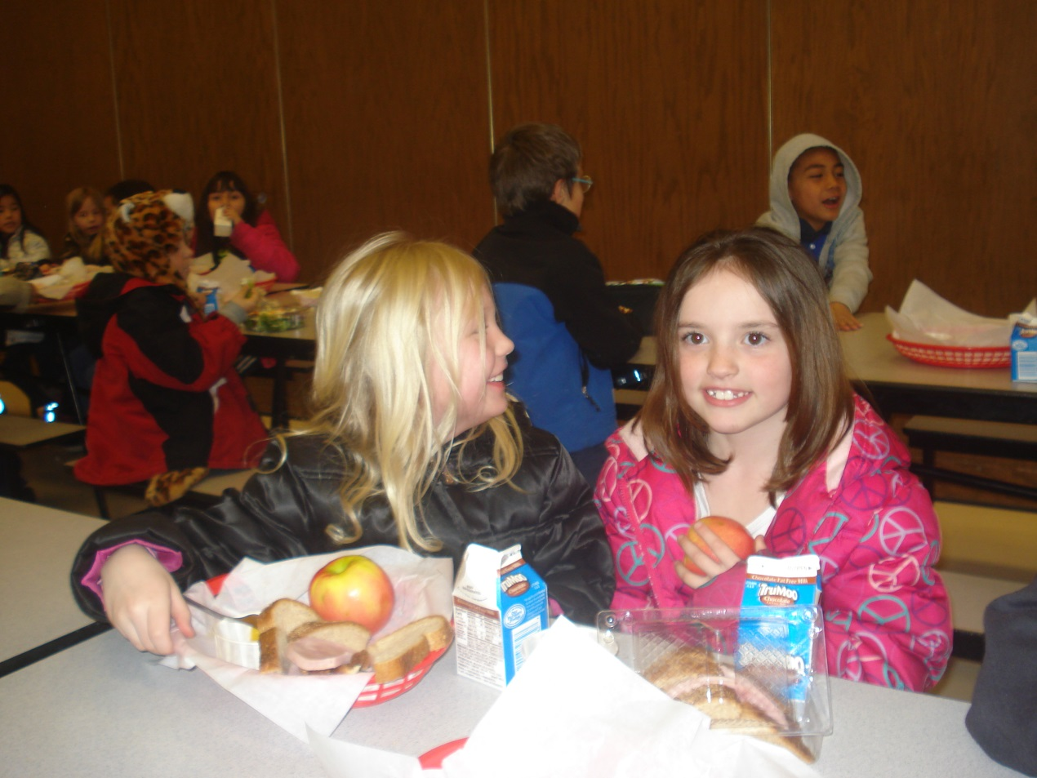
Talk respectfully to others
Talk in a respectful voice.
NO complaining to others.

Slide 5
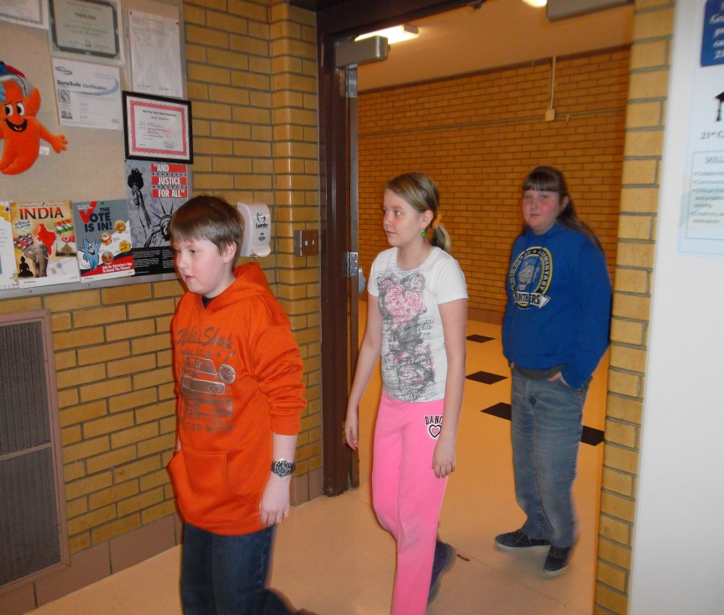
No running in the lunch room
If someone was running what would you do?
Tell them to stop running.

Slide 6
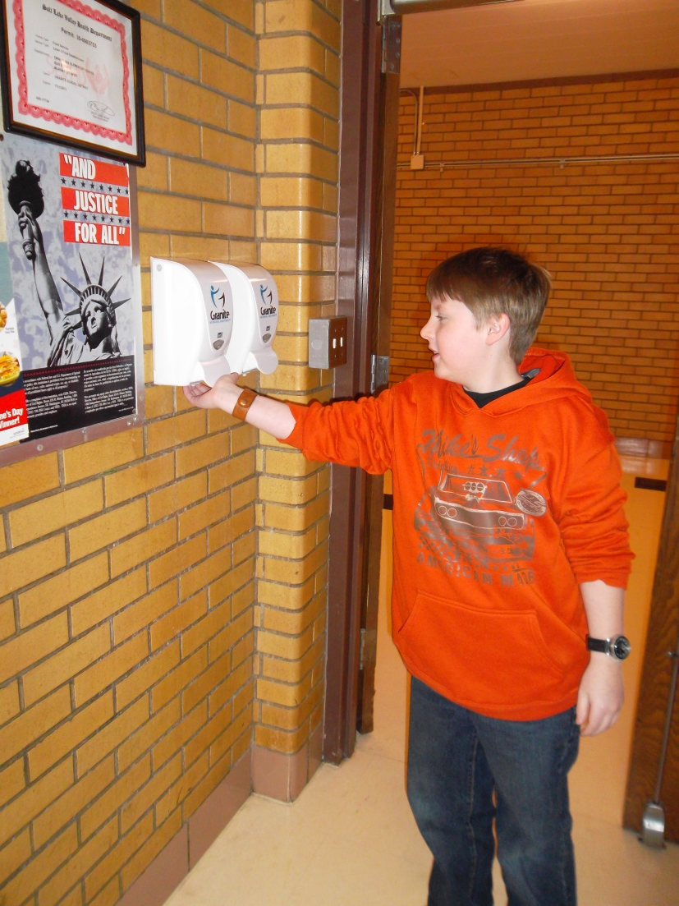
Use hand sanitizer
Use hand sanitizer so that you don’t spread germs.

Slide 7
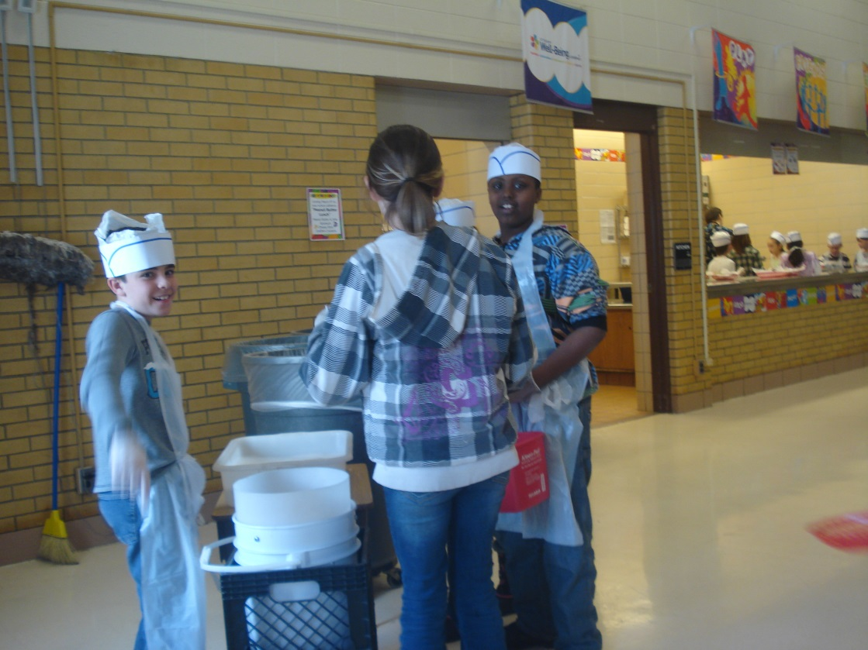
Keep food in lunchroom
Keep food in lunchroom.
Do not take food into the bathroom, outside, or in your class.

Slide 8
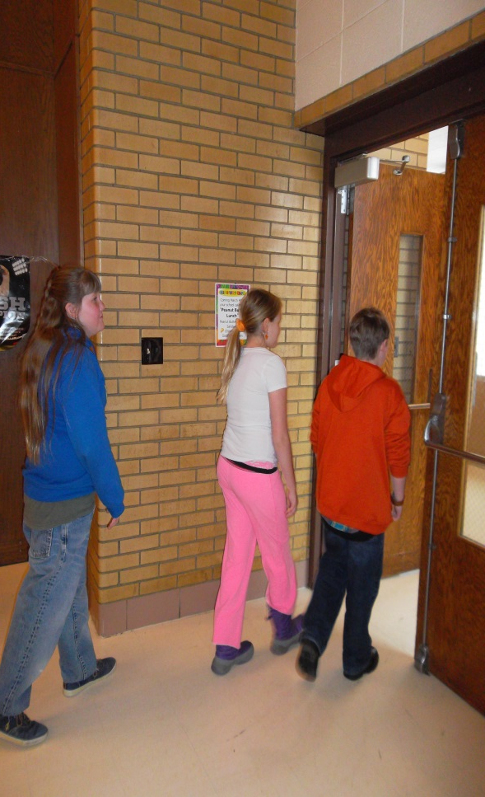
Eat and leave
Eat your food quickly so others can eat.
DO NOT take food out on the playground.

Slide 9
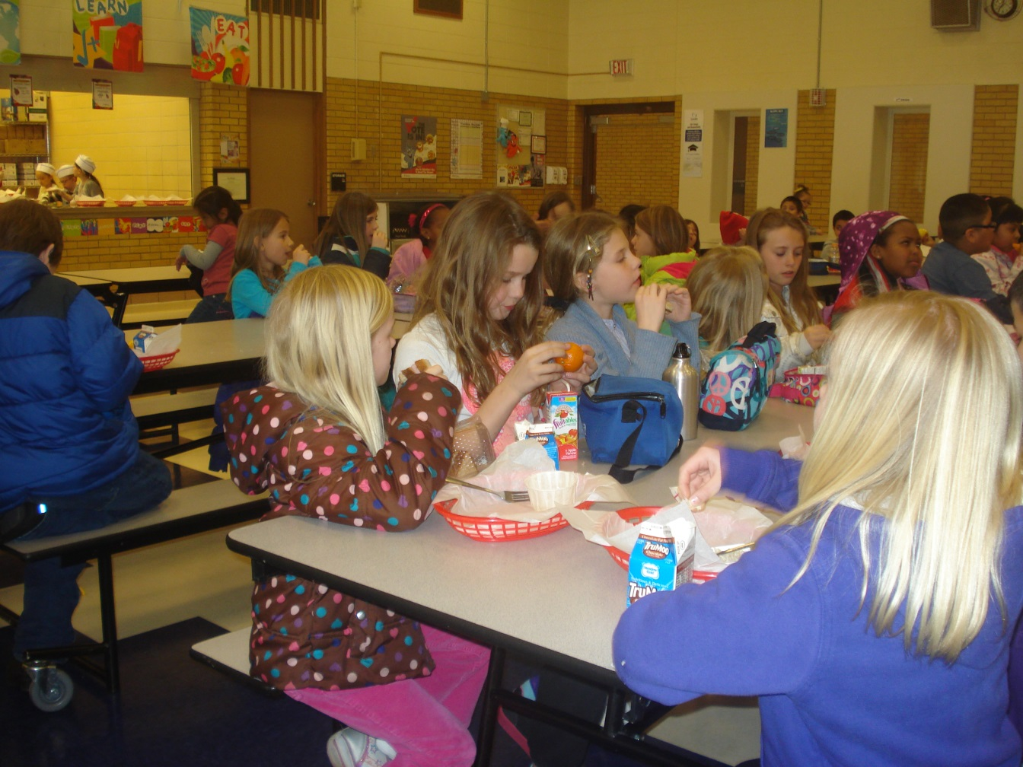
Stay at assigned table
Stay at your grade level table.

Slide 10
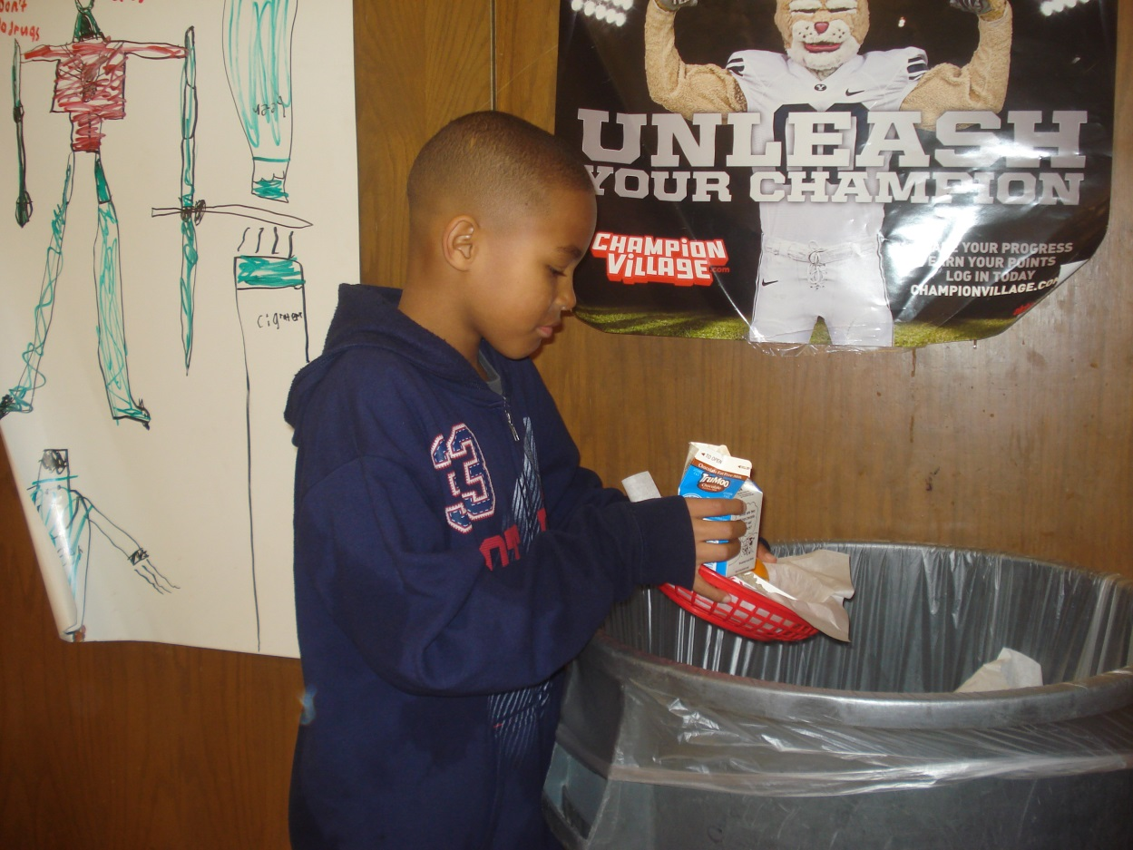
Throw away your food
Throw away your food—NOT your silverware and baskets.

Slide 11
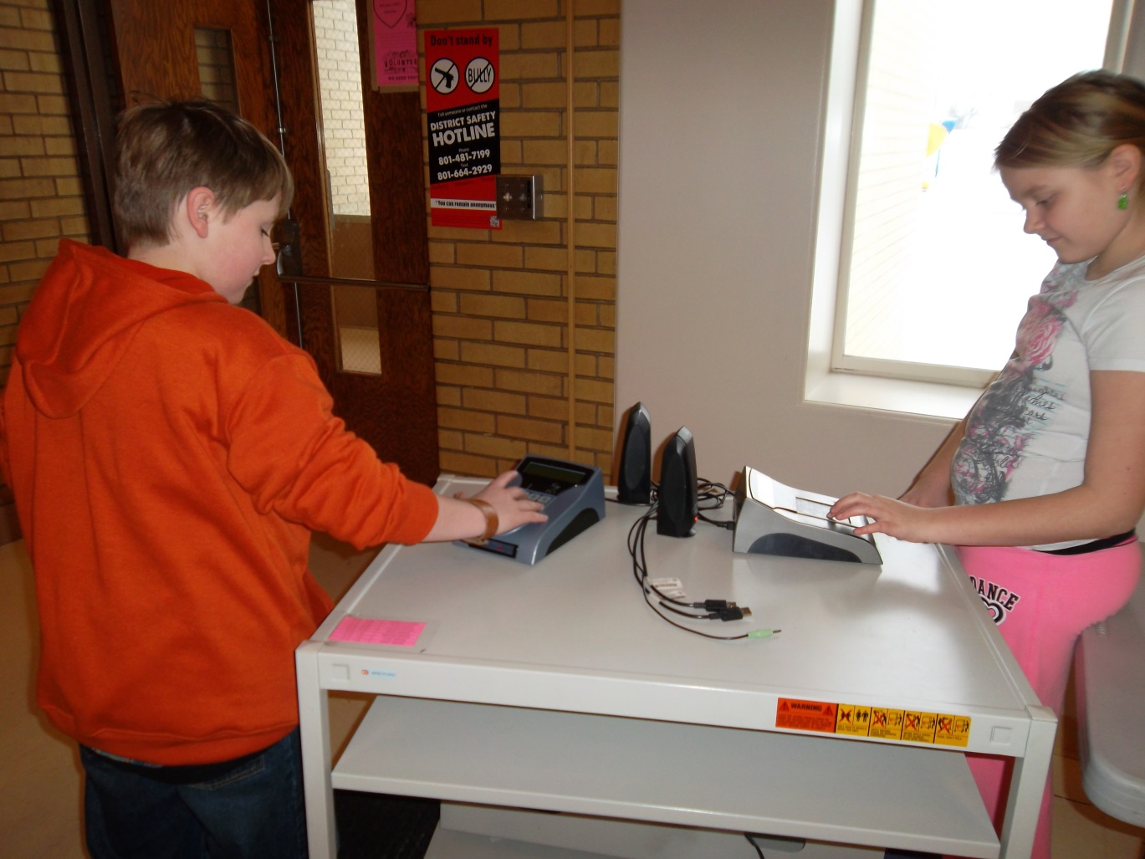
Put in pin number
Be respectful while punching in your pin number.

Slide 12
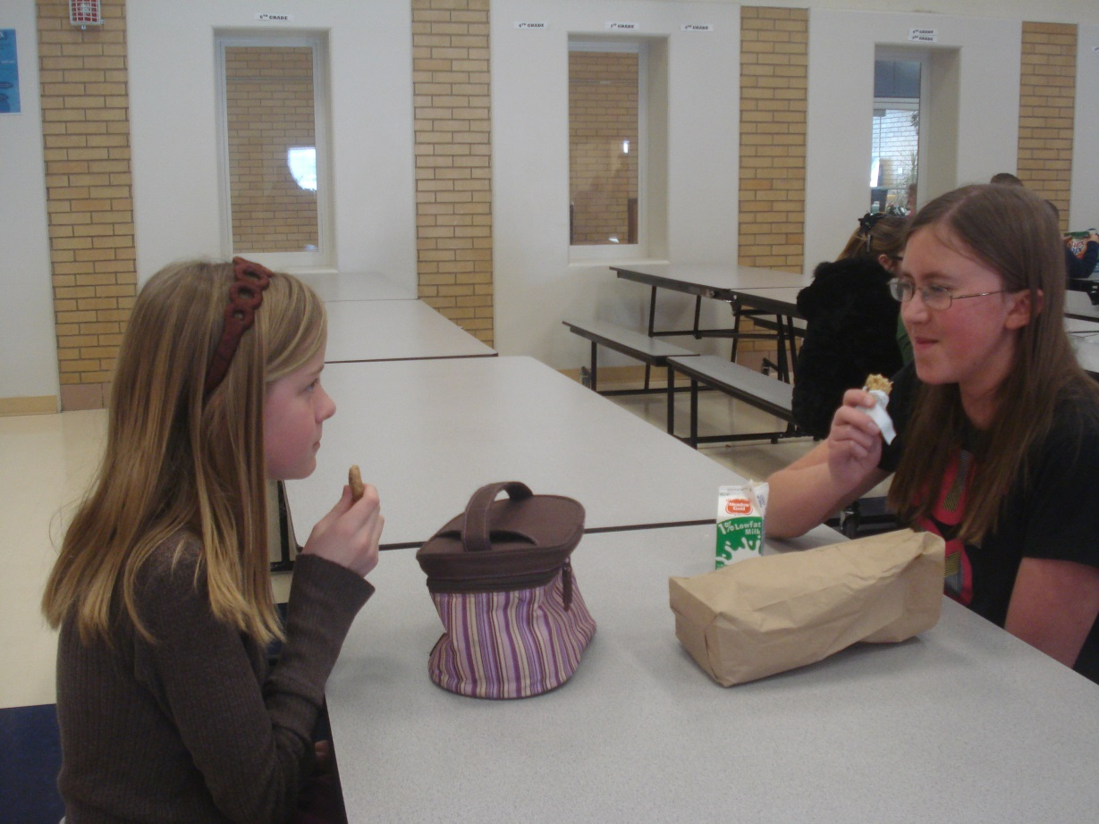
Keep hands , feet, and other objects to self
No fighting.
Sit quietly.

Slide 13
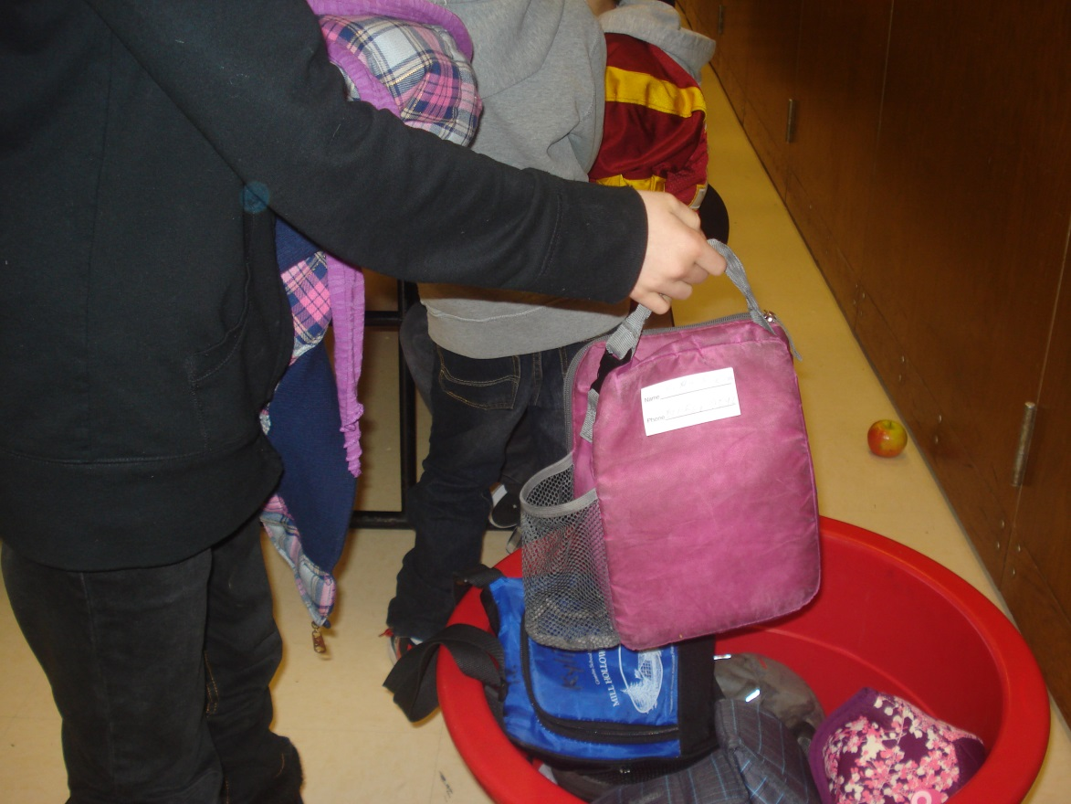
Put lunch boxes in basket
Put your lunch box in your assigned basket.

Slide 14
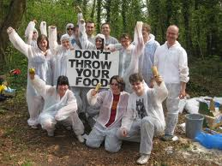
NO throwing food!
DON’T START FOOD FIGHTS!

Slide 15
Lets review the rules of the lunchroom
Eat your own food
Talk respectfully to others
No running in lunchroom
Keep tables and floors clean
Use hand sanitizer
Keep food in lunchroom

